Slide 1
VIDEO GAMES ANALYSIS: GLOBAL SALES & TRENDS
Agenda
Introduction/Observations
Probing Questions
Visuals
Insights

Slide 2
Introduction/Observation
This report contains data gotten from the analysis of the Video Games Sales Dataset.
My initial observation of the data was that it had a library of over 64,000 rows and 11 columns which included the Game title, console, genre, publisher, developer, critic score, total sales, North American Sales, Japanese sales, European sales, other sales, each game’s release and updated dates.
I noticed some of the games didn’t have complete data, however, I worked with the data available.
I also noticed that some video games were more dominant than the others when looking through the revenue and the critic scores.

Slide 3
Probing Questions
My findings led me to 3 major probing questions which are the main pillars of this report and they are:
Which genre and publishers lead the market in the total global sales? This is to confirm the market dominance.
What are the sales patterns in the different regions? This is to know the regional preferences
What is the relation of the average critic score to each genre? This would tell us the genres which are mostly criticised.

Slide 4
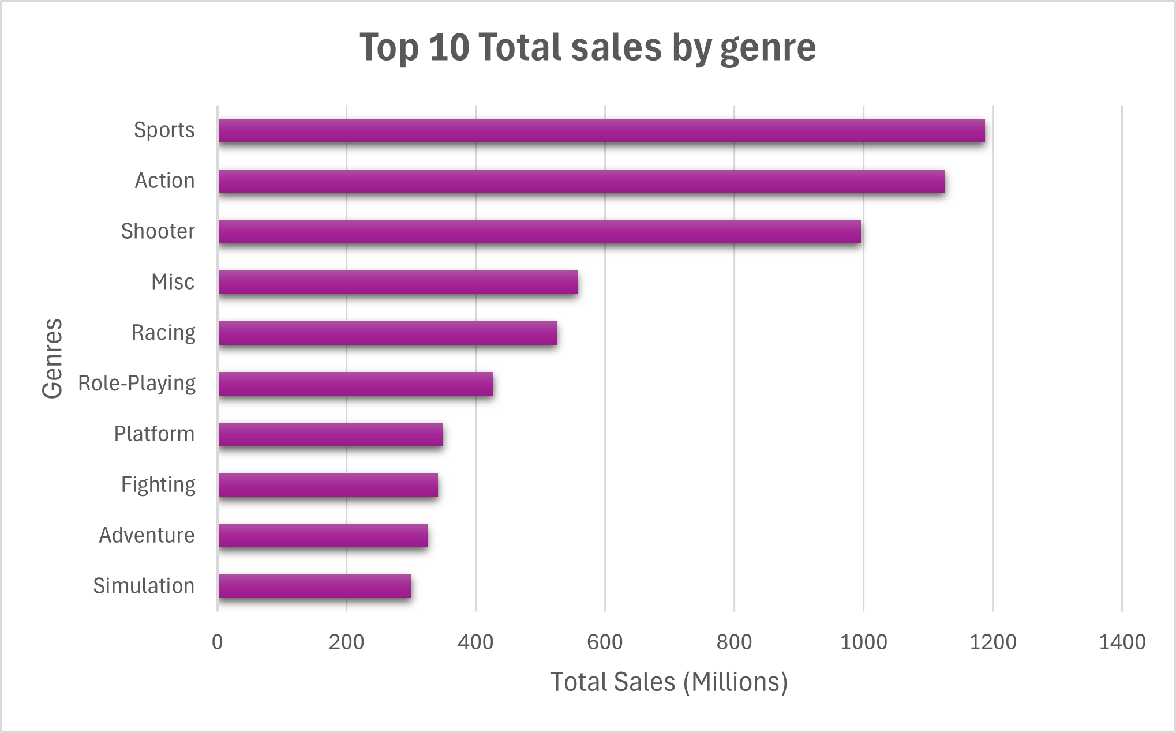
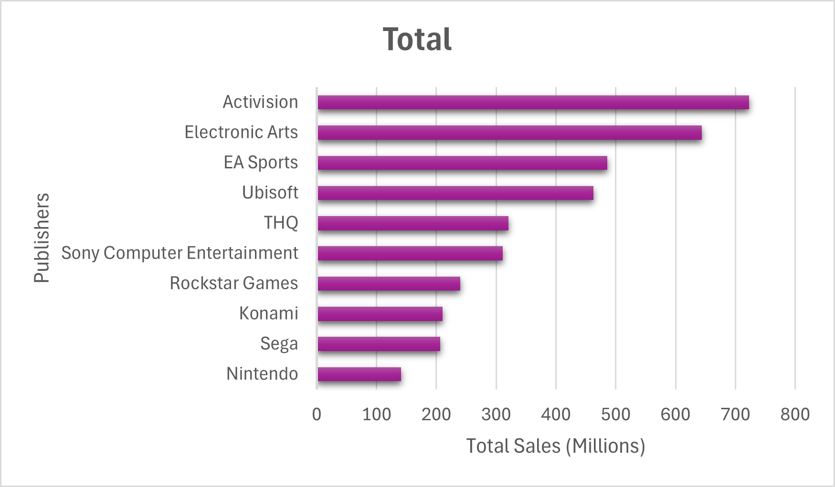
Visuals
These charts shows us the dominant publishers and genres by sales. Here we have only selected the top 10 in each category

Slide 5
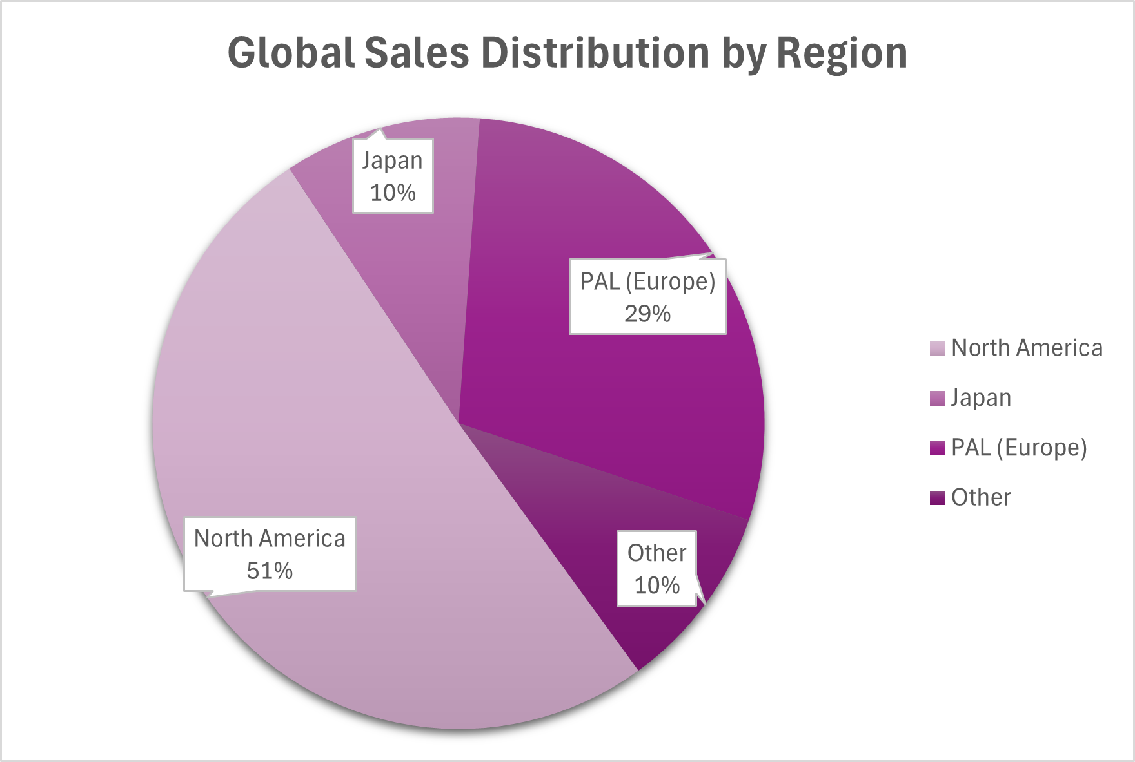
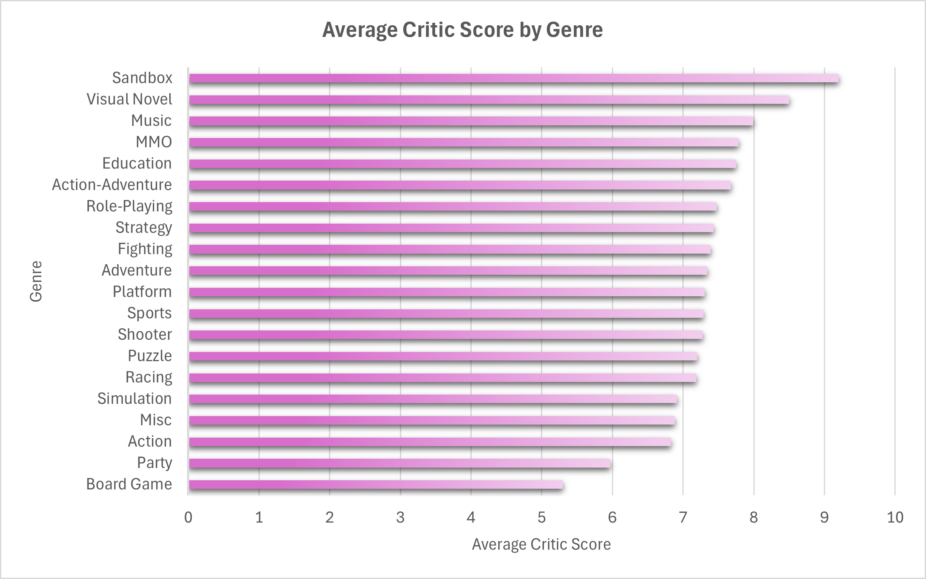
Visuals
These charts us the regional preference of video games and which genres have been loved or hated by the critics

Slide 6
Insights
The data reveals that the Sport, Action and Shooter genres are the primary drivers of global revenue.
The North American Region gathers the most sales for all video game types.
The best publishers are Activision as they dominated in the global sales of their games in total sales.
The critic score doesn’t necessarily matter as people will still pay for the game they prefer not the ones that score the highest based on the critics.

